Slide 1

Project Group No: 32
VPKBIET, Baramati
Automated Smart Farming For Orchids Using IOT
Project Domain: Internet of Things
1. Kajale Anirudhha Gulab [Roll No: 2142029] [PRN No.71927828H]
2. Kadam Manoj Krushna [Roll No: 2142027] [PRN No.72002580L]
3. Bhong Shashikant Narayan [Roll No: 2142005] [PRN No.71711513F]
Project Guide: Prof. R. K. Shastri

Slide 2
Index
Introduction
Origin of Problem Statement & Motivation
Literature Review
Objectives
Block Diagram
Methodology & Development Tools
Timeline
Work done till date
Plan for NEXT 6 Months
References

Slide 3
Introduction
The atmospheric or environmental condition plays an important role for growth of the orchids Greenhouse. farmers cannot detect level of humidity inside the green house.
They only know the condition inside the green house manually. If the condition is too dry, they will give water to the orchids, but if it is too humid, they will open the rooftop of the green house, specially in the daylight.
With the help of IOT we are going to control the orchid greenhouse with the Temperature, LDR and soil moisture sensor. This IOT based greenhouse can be controlled from anywhere by focusing the environmental parameters like temperature and humidity.

Slide 4
Origin of Problem Statement & Motivation
Green house is used to effectively growth of orchid and other crops, but it grow effectively when orchid and crop get good climate and atmosphere.
Green house is used to protect the orchid and crop from many disease and help to grow more orchid and crops.
If the certain condition are not maintained then orchid can be distorted and it is a huge loss of farmer.
It is difficult to farmer maintain all the condition manually then were this system is helpful.
This system helps to maintain all the condition effectively at desire atmosphere in the greenhouse.

Slide 5
Literature Review
Sr. No | Research Paper Title and Publication Details | Authors | Methodology | Results/Conclusion & Discussion
1 | An Automated Greenhouse Monitoring and Controlling System using Sensors and Solar Power. | By MD Jiabul Hoque, Md. Razu Ahmed and Saif Hannan | In order to develop a successful greenhouse system, the following parameters such as temperature, light intensity, humidity, and moisture of the soil should be adjusted in such a way that different plants can grow perfectly. Therefore, continuous monitoring of temperature, light intensity, humidity, and moisture of the soil is most important in greenhouse system.
2 | Design and Implementation of IOT Based Greenhouse Environment Monitoring and Controlling System Using Arduino Platform | By Devanath S, Hemanth Kumar, Rachita Shettar | The implemented greenhouse system consists of two section, monitoring section and controlling section. The monitoring section consists of DHT11 sensor, LDR sensor, Soil moisture Sensor to monitor the environmental parameters.

Slide 6
Objectives
Main objectives of this project to automate greenhouse with automatic monitoring and controlling system.
Constantly monitor and control environmental conditions in greenhouse. It focus on saving water, increasing efficiency and reducing the environmental impacts on orchid growth.
The user can be seeing the atmospheric conditions of the greenhouse orchid on cloud and control the greenhouse from faraway places.
It is to increase the production of Orchid To save water, power etc.

Slide 7
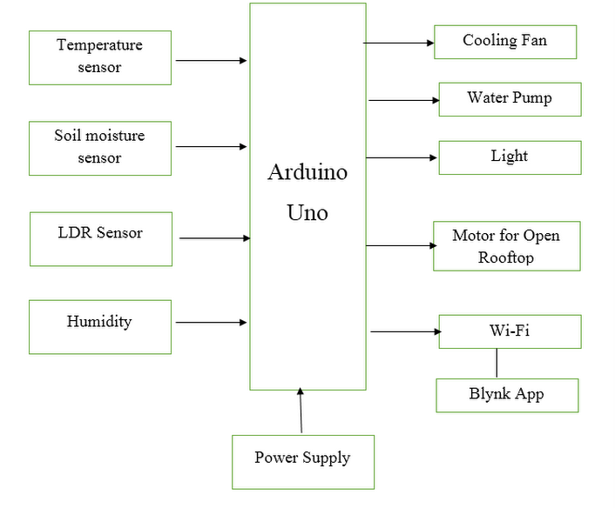
Block Diagram

Slide 8
Methodology & Development Tools
The implemented greenhouse system consists of two sections, monitoring section and controlling section. The monitoring section consists of DHT11 sensor, LDR sensor, Soil moisture sensor and Humidity Sensor to monitor the environmental parameters.
A esp8266 wifi is used to send environmental parameters to IOT cloud platform. The controlling section consists of cooling fan, water pump, artificial light and water pump. Arduino is the heart of the system.

Slide 9
Developments Tools
A. Hardware
Arduino Uno
Esp8266 Wi-Fi module
Temperature Sensor, LDR Sensor, Rain Sensor, Soil Moisture Sensor
DC fan, Water Pump, Light
PCB
B. Software
Arduino IDE
TinkerCad
Proteus

Slide 10
Timeline
Activity | Aug 21 | Sept 21 | Nov 21 | Jan 22 | Feb22 | March 22
Literature Review and study. | Done
Methodology of project, searched for the required components and completion of the synopsis. |  | Done
Components testing and design system. |  |  | _
Arduino Uno Coding |  |  |  | _
Testing and Troubleshooting |  |  |  |  | _
Final Write-up & Thesis Submission |  |  |  |  |  | _

Slide 11
Work done till date
Plan for NEXT 6 Months
Time | Activity
Oct 2021 | Literature Review and Study
Nov 2021 | Components testing and
Dec 2021 | Design system.
Jan 2022 | Arduino Uno Coding and Web designing.
Feb 2022 | Testing and Troubleshooting
March 2022 | Final Writeup and Thesis Submission
Search topics based on IoT technology.
After searching topics, discussed with the guide and finalized the topic.
Literature Review.
Searched about the topic and methodology of project.
Designed the flowchart and block diagram after discussed with the guide.
Completion of the synopsis.
Submitted the synopsis.

Slide 12
References
Rouibah, N.; Barazane, L.; Benghanem, M.; Mellit, A. IoT-based low-cost prototype for online monitoring of maximum output power of domestic photovoltaic systems. ETRI J. 2021, 43, 459–470. [CrossRef]
Engineersgarage. Available online: https://www.engineersgarage.com/acs712-current-sensor-witharduino/ (accessed on 20 April 2021)
Arduino UNO: Complete Ultrasonic Sensor Guide (HC-SR04). Available online: https://www.instructables.com/Arduino-UNO-Complete-Ultrasonic-Sensor-Guide-HC-SR/ (accessed on 13 August 2021).
Castañeda-Miranda, A.; Castaño-Meneses, V.M. Internet of things for smart farming and frost intelligent control in greenhouses. Comput. Electron. Agric. 2020, 176, 105614. [CrossRef]
Huang, K.; Shu, L.; Li, K.; Yang, F.; Han, G.; Wang, X.; Pearson, S. Photovoltaic Agricultural Internet of Things Towards Realizing the Next Generation of Smart Farming. IEEE Access 2020, 8, 76300–76312. [CrossRef]

Slide 13
Thank you

